Slide 1
Be + going + to
Future with

Slide 2
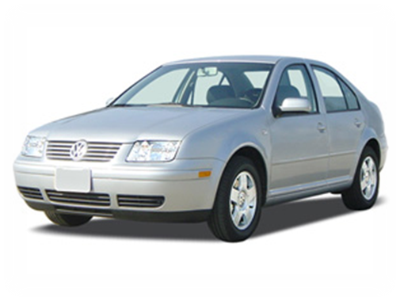
The future with be going to
The future with be going to is used :
-to express future plans
Past
Present
Future
For example:
I am going to buy a car tomorrow
S + BE + going + to + verb (bf) + compliment

Slide 3
Useful time expressions
Tonight
Tomorrow
This summer
Next month/year/winter
In two months
After graduation/ the party/ ICPNA

Slide 4

What is he going to do this weekend?
play
He is going to play in a soccer tournament and he is going to take a break after the tournament.

Slide 5

What are they going to do tonight?
They are going to dance tonight.

Slide 6


What are Lulu and Lalo going to do this summer?
They are going to join the tennis team
And they are going to learn how to roller-skate ☺

Slide 7
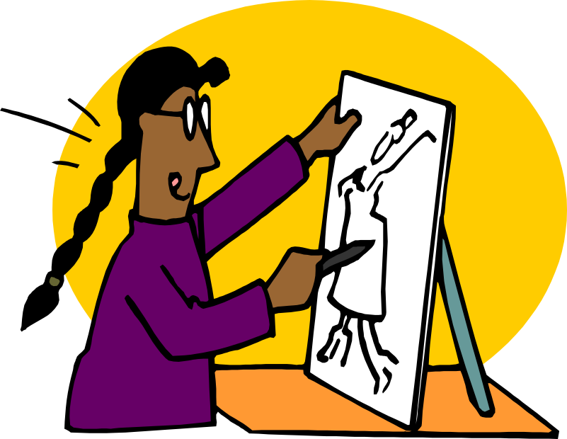
What is she going to study?
art
She is going to study art ☺

Slide 8
Yes/No questions with Be going to
Wh- questions with Be going to
Where is
she
going to travel?
Wh- + Be + S + going to + Verb (bf)
Are
you
going to study art?
Be + S + going to + Verb (bf)

Slide 9
WH- questions with
Be going to
What is
Laura
going to do this summer?
Laura is going to travel this summer.
Where is
Laura
going to travel?
She is going to travel to Istambul.
When is
she
going to travel?
She is going to travel on January.

Slide 10
WH- questions with Be going to
Who is
Laura
going to travel with?
Laura is going to travel with her sister.
Why is
Laura
going to travel?
She is going to travel because she loves to travel.
Where is
she
going to travel?
Wh- + Be + S + going to + Verb (bf)

Slide 11
Yes/No questions in English
Is
Laura
going to study art?
Yes, she is. Laura is going to study art next month.
Is
Mario
going to watch a movie with us?
No, he isn’t. He is going to study for his exam.
Is
your brother
going to work at Britanico?
No, he isn’t. He is going to work at ICPNA ☺

Slide 12

10-1 Let’s Practice
yes
go to work
Are you going to go to work
on Monday?
Yes, I am
I’m going to go to work on Monday
__________. _________________________.

Slide 13
10-1 Let’s Practice
__________. _________________________________
no
watch the news
No, I’m not
I’m not going to watch the news on TV
Are you going to
watch the news on TV?

Slide 14
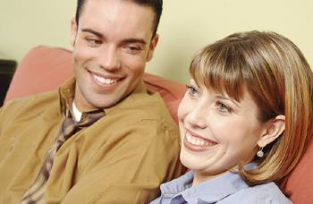
10-1 Let’s Practice
yes
study English
Yes, I am
I’m going to study English this year
__________. ___________________________.
Are you going to
study English
this year?

Slide 15

3-2 FORMS WITH BE GOING TO
(e) “Come on, we’re gonna go to the party!”
informal
not usually
written
Be
gonna
going
to

Slide 16
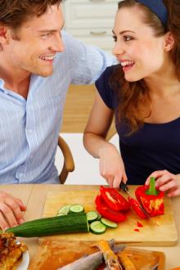
3-1, 3-2 LET'S PRACTICE
be going to
we, eat
are we going to eat
What ________________ for dinner?

Slide 17
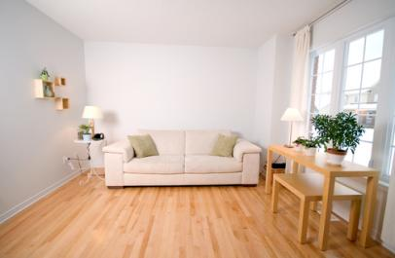
3-1, 3-2 LET'S PRACTICE
be going to
you, paint
are you going to paint
What color __________________
your living room?

Slide 18
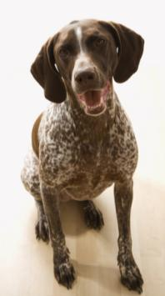
3-1, 3-2 LET'S PRACTICE
be going to
bark
going to bark
___ that dog ___________ all day?
Is

